Slide 1

Titanic: Can Machine Learning Decode Who Survived?
A Data Science Approach to a Historical Tragedy
By: Anisa Fitriani | Digital Skill Fair 38.0 | Data Science

Slide 2
Table of contents
01
05
Introduction
Data Preprocessing
Exploratory Data Analysis (EDA)
02
03
Feature Engineering
06
Data Modeling
07
Data Preprocessing
Conclusion
04
Data Visualization
Digital Skill Fair 3.80
Data Science
01

Slide 3
Introduction
Urgency
Background
Problem Statement
The sinking of the Titanic in 1912 is one of the most recognisable maritime disasters, killing more than 1,500 people. Factors such as gender, age affect the chances of survival, so the data of the passengers is interesting to analyse.
The ability to analyse complex data is important in decision making. This project exercises pre processing, visualization and machine learning skills to solve real problems.
The problem in this project is how to handle duplicate data and missing values in the Titanic dataset, and apply machine learning models to identify passengers.
Digital Skill Fair 3.80
Data Science
02

Slide 4
Introduction
Project Goals
Initial exploration of the Titanic dataset to understand the data.
Cleaned the data from duplicates and missing values for analysis accuracy.
Presenting key information through basic visualizations that are easy to understand.
Built machine learning models to predict passenger survival.
Digital Skill Fair 3.80
Data Science
03

Slide 5
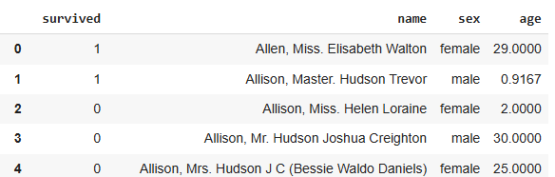
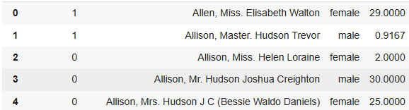
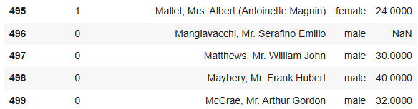
Data Overview
Total Columns : 4
Total Row : 500
This dataset contains information about the Titanic passengers, including their personal data and survival status. Some of the key features analysed include age, gender, and survival outcome.
Digital Skill Fair 3.80
Data Science
04

Slide 6
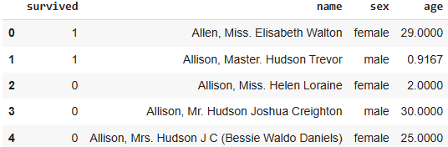
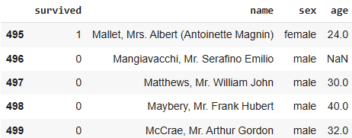
Head & Tail
Exploratory Data Analysis
(EDA)
Show top 5 rows of the data
Show last 5 row of the data
Digital Skill Fair 3.80
Data Science
05

Slide 7
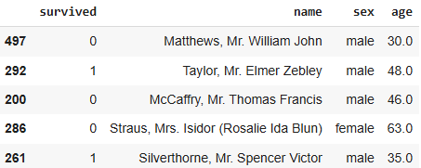
Random Sample
Exploratory Data Analysis
(EDA)
Observations:
The name and sex columns are non-numeric with object data types.
The survived column is binary, consisting of values 0 and 1.
The name column includes personal titles and is consistently formatted.
Some columns contain missing values, indicating the need for data cleaning.
Showing random sample of 5
Digital Skill Fair 3.80
Data Science
06

Slide 8
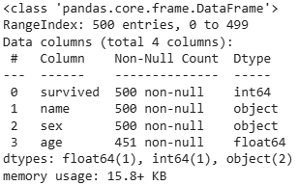
Info Data
Exploratory Data Analysis
(EDA)
Observations:
The age column has 49 missing values, which will be handled later.
All data types appear to match their respective columns.
Showing data information
Digital Skill Fair 3.80
Data Science
07

Slide 9

Classify Data Columns
Exploratory Data Analysis
(EDA)
Split columns into categorical and numeric types to apply into
appropriate summary statistics
Digital Skill Fair 3.80
Data Science
08

Slide 10
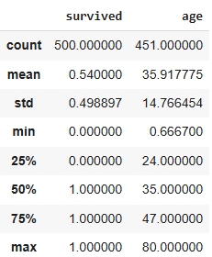
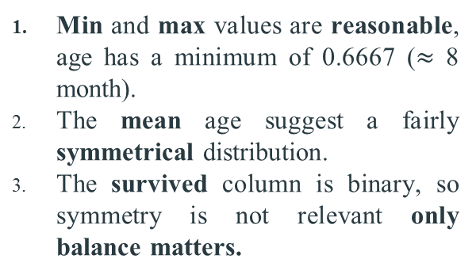
Describe Numerical Columns
Exploratory Data Analysis
(EDA)
Observations:
Min and max values are reasonable, age has a minimum of 0.6667 ($≈$ 8 month).
The mean age suggest a fairly symmetrical distribution.
The survived column is binary, so symmetry is not relevant only balance matters.
Digital Skill Fair 3.80
Data Science
09

Slide 11
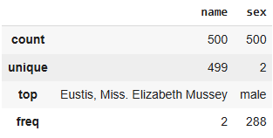
Describe Categorical Columns
Exploratory Data Analysis
(EDA)
Observations:
The name column has 499 unique entries, meaning 2 passengers share the same name.
The duplicate name is Eustis, Miss. Elizabeth Mussey.
The are 288 male passengers, and the rest are female.
Digital Skill Fair 3.80
Data Science
10

Slide 12

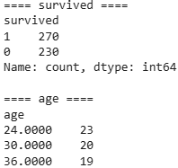
Numerical Details
Exploratory Data Analysis
(EDA)
Observations:
Out of 500 passengers, 270 survived and 230 did not, indicating a relatively balanced.
Ages 24, 30, and 36 appear most frequently, suggesting these were the most common ages among passengers.
Digital Skill Fair 3.80
Data Science
11

Slide 13
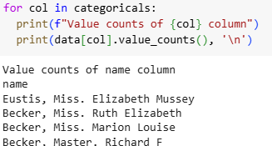


Categorical Details
Exploratory Data Analysis
(EDA)
Observations:
There are two entries with the same name ‘Eutis, Miss. Elizabeth Mussey’.
The dataset contains 288 male passengers and 212 female passengers, indicating a gender imbalance.
Digital Skill Fair 3.80
Data Science
12

Slide 14

Detecting Duplicate
Data Cleaning
The output of this code is not 1, which indicates that there are duplicate entries.
The name Eustis, Miss. Elizabeth Mussey’is the only duplicate found in the dataset, with no other repeated entries detected.
Digital Skill Fair 3.80
Data Science
13

Slide 15
Handling Duplicate
Data Cleaning
Using .drop_duplicates() to clean duplicate data
The output is 1, indicating that duplicate handling was successful
Digital Skill Fair 3.80
Data Science
14

Slide 16
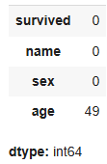

Detecting Null Values
Data Cleaning
Percentage of null values in each column
The percentage of missing data is below 20%, so we can handle numeric data using the median and categorical data using the mode. Since categorical columns such as name and sex, as well as one of the numerical columns, survived, have no missing values, our focus is on the numerical column age.
Digital Skill Fair 3.80
Data Science
15

Slide 17

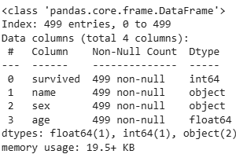
Handling Null Values
Data Cleaning
Because age is a numerical column, missing entries are handled by replacing them with the median.
Missing values have been handled successfully.
Digital Skill Fair 3.80
Data Science
16

Slide 18
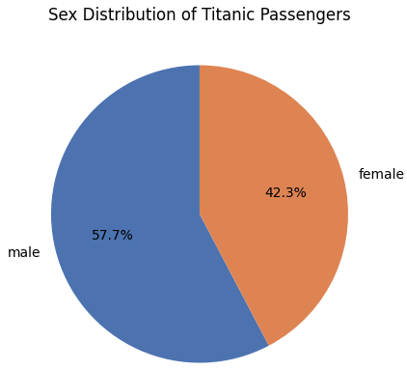
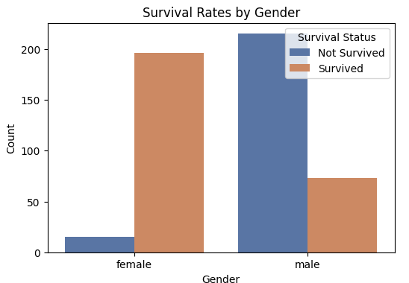
Data Visualization
Male passengers, making up 57.7% of the total, outnumbered females 42.3%, which may have influenced survival outcomes due to historical prioritization during the Titanic tragedy.
The bar plot analysis revealed that the number of female passengers who survived was much higher than that of male passengers.
Digital Skill Fair 3.80
Data Science
17

Slide 19
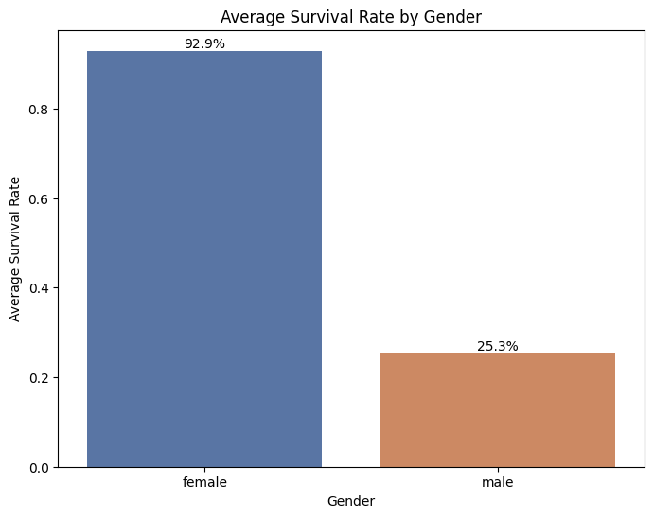
Data Visualization
The survival rate shows a clear gap between genders, 92.89% of females survived, while only 25.35% of males did. This suggests that gender likely influenced survival, possibly due to evacuation rules that prioritized women.
Digital Skill Fair 3.80
Data Science
18

Slide 20
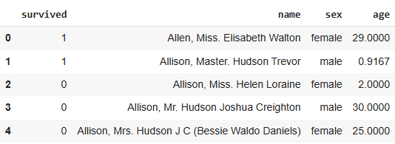
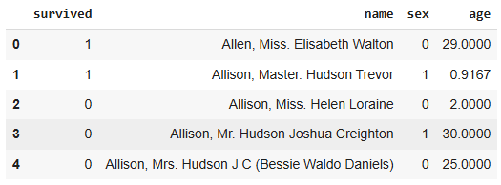
Label Encorder
Feature Engineering
Label Encoding is used to convert categorical data into numeric types. For example, it transforms the 'Gender' variable into 0 for 'Female' and 1 for 'Male'.
Digital Skill Fair 3.80
Data Science
19

Slide 21
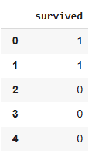
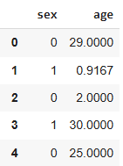
Feature Selection
Feature Engineering
Feature selection is the process of identifying the most relevant features to enhance model performance.
In this case, gender and age were chosen as the features (X), while the column indicating passenger survival served as the target variable (y).
Digital Skill Fair 3.80
Data Science
20

Slide 22
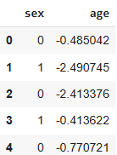
Feature Scaling
Feature Engineering
Feature scaling aims to ensure that numerical features contribute equally to the model.
Only the Age feature is scaled due to its wide range (0–80 years), which could otherwise disproportionately affect the model, while the 'sex' feature, with only values 0 and 1, is less variable.
Digital Skill Fair 3.80
Data Science
21

Slide 23
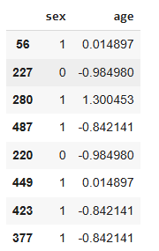
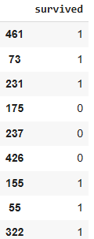
Splitting Data
Feature Engineering
The dataset is divided into two parts: 80% for training the model (training data) and 20% for testing its performance (testing data).
This split helps ensure that the model does not overfit and can generalize well to new data.
Test Data
Train Data
Digital Skill Fair 3.80
Data Science
22

Slide 24
K-Nearest Neighboars (KNN)
Data Modeling
Support Vector Machine
(SVM)
Decision Tree
A Decision Tree is a model that predicts outcomes by asking sequential questions about data features. It splits the data into branches according to the responses, ending in a final prediction at each leaf node.
KNN is a classification algorithm that determines the category of a data point based on the classes of its nearest neighboars in the feature space. It considers a number of nearest neighboars (k) and assigns the majority class among them to the new data point.
SVM work by finding the optimal separating line (hyperplane) that divides data from two or more classes in the feature space. The goal is to maximize the margin (distance) between the closest data points of each class called support vectors so the model can distinguish between classes as effectively as possible.
Digital Skill Fair 3.80
Data Science
23

Slide 25
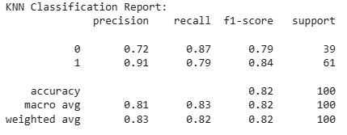
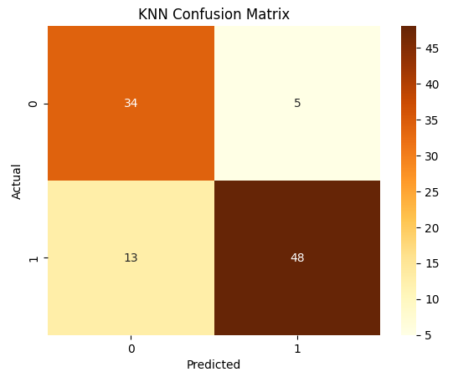
K-Nearest Neighboars (KNN)
Data Modeling
Accuracy model SVM : 82 %
Digital Skill Fair 3.80
Data Science
24

Slide 26
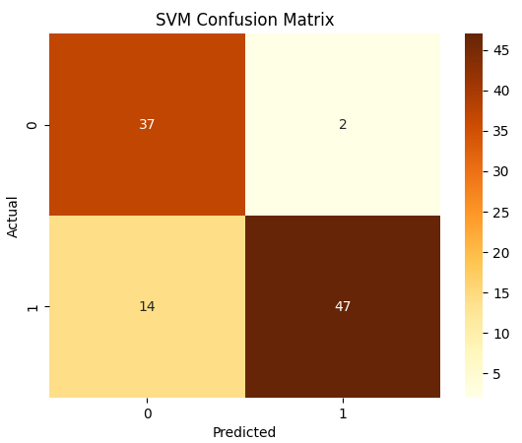
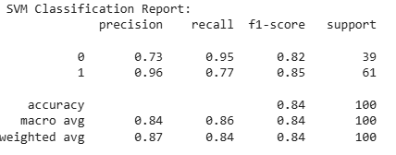
Data Modeling
Support Vector Machine
(SVM)
Accuracy model SVM : 84 %
Digital Skill Fair 3.80
Data Science
25

Slide 27
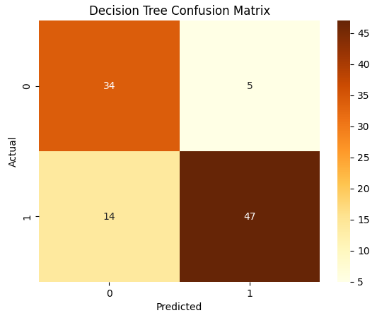
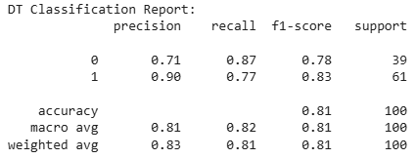
Decision Tree
Data Modeling
Accuracy model Decision Tree : 81 %
Digital Skill Fair 3.80
Data Science
26

Slide 28
Conclusion
Duplicate data and missing values have been successfully handled.
Based on the visualization results after the data cleaning process, female passengers were significantly more likely to survive.
SVM achieved the highest accuracy at 84%, KNN followed with an accuracy of 82%, Decision Tree showed moderate results with a lower accuracy of 81%.
Digital Skill Fair 3.80
Data Science
27

Slide 29
Thanks you!
Contact Person :
Gmail : afitriani1122@gmail.com
LinkedIn : https://www.linkedin.com/in/anisa-fitriani-12932428a

